Slide 1


BELAJAR BERSAMA
IRIS CLASS – BATCH II

Slide 2




IRIS CLASS – BATCH II
CODEIGNITER
CODEIGNITER
CODEIGNITER

Slide 3



Sebelum, belajar
Pemanasan Dulu Yuk
SSID : IRIS Class – CI 2
PASS : kelastambahan2
http://bit.ly/pretest_iris

Slide 4
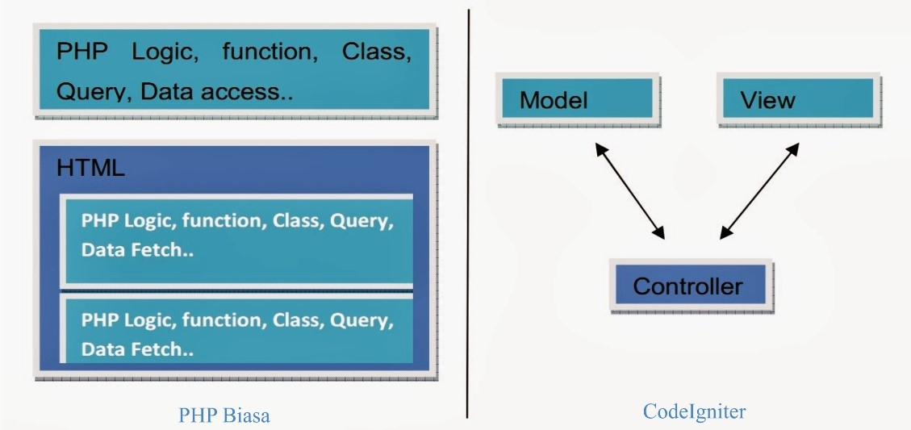
Sedikit, tentang
Who am I ?
HTML vs CodeIgniter
Sumber: IDCloudHost

Slide 5
Today ?
MVC
DATABASE
CRD

Slide 6
Sedikit, tentang
M V C
Model – View – Control

Slide 7
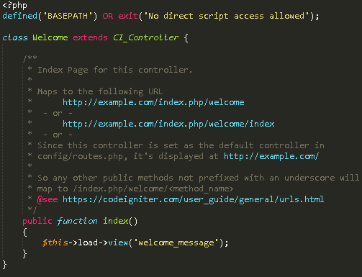
MODEL VIEW CONTROL
CONTROLLER

Slide 8
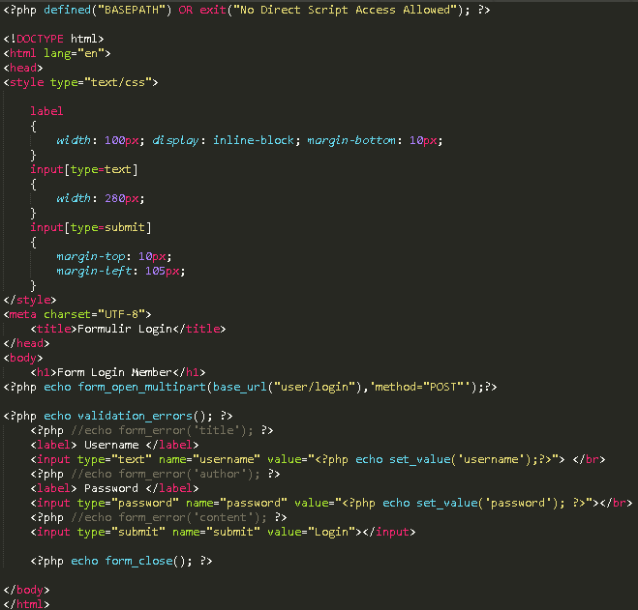
MODEL VIEW CONTROL
VIEW

Slide 9
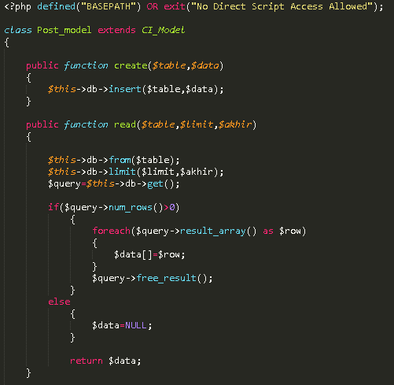
MODEL VIEW CONTROL
MODEL

Slide 10
Sedikit, tentang
DATABASE
Table – Relation

Slide 11
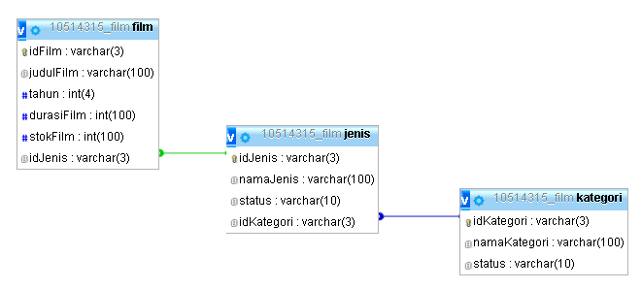
Database
Tahukah Kamu; Maksud Dari Gambar Ini ?

Slide 12
Database
Tabel
Row

Slide 13
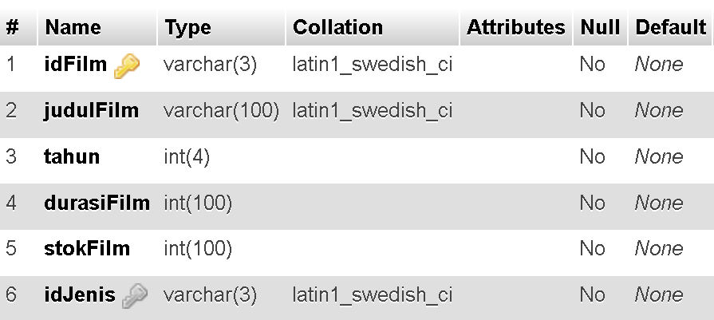
Database
Table; Film

Slide 14
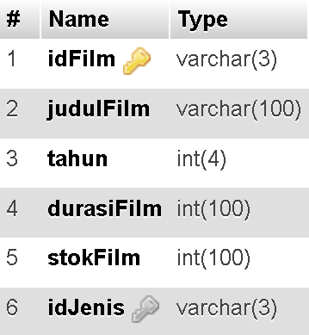
Database
Table; Film
Nama Row
Tipe Data

Slide 15
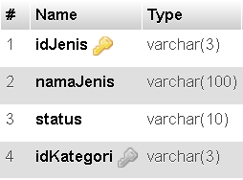



Database
Table Relation
Primary Key
Foreign Key

Slide 16
Database
Dokumentasi; Database
http://localhost/{folder_project}/user_guide
Cari dengan kata kunci “database”

Slide 17
Sedikit, tentang
C R D
Create – Read – Delete

Slide 18
Database
Table; Film
Nama Row
Tipe Data

